Slide 1
Instacart Product Recommendations
Ada Jing, Ilya Korzhenevich, Jessica Bao, Katy Kiefer, Kaylie Chen

Slide 2
Overview
01
02
03
04
05
Exploratory Data Analysis
Segmentation Clustering + PCA
Market Basket Analysis
Recommendation Systems
Conclusion
Our object is to analyze over 3 million Instacart items in orders to draw insight and develop a recommendation system to help Instacart increase its sales and further develop its business strategies.
Examining popularity of products, lengths between orders, etc
Analyze customer buying patterns by clustering based on products bought
Looking at buying patterns between products and advise business strategies
Recommend customers products to add based on previously added items
Wrap-up of our analysis and recommendations

Slide 3
EXPLORATORY ANALYSIS
Data Profile
Dating with the data
Insight
Six csv files
Exploring data via charts and numbers
Leverage understanding to spearhead mining

Slide 4
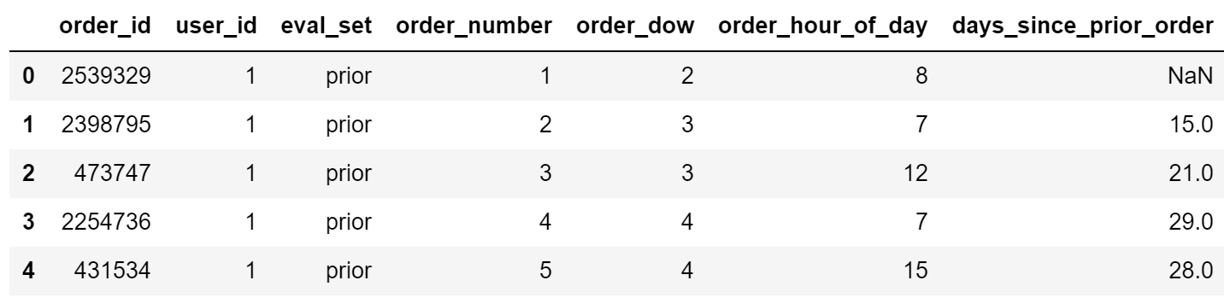
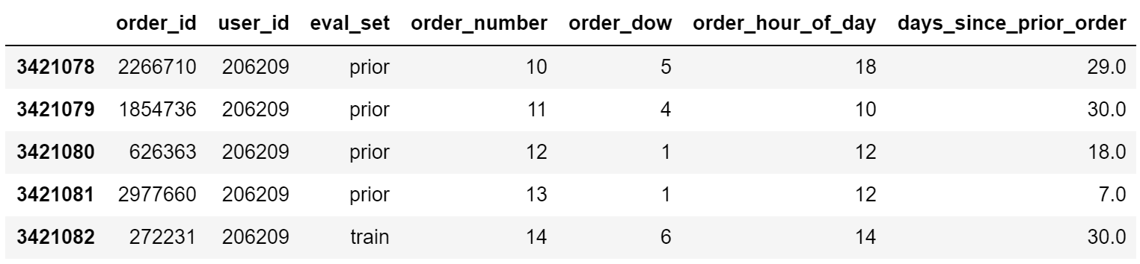
Orders.csv
3.4M+ rows

Slide 5
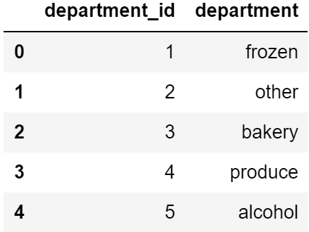
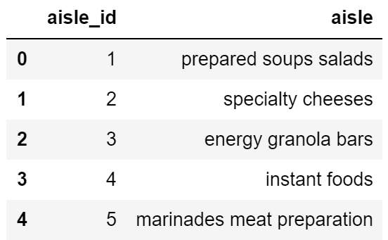
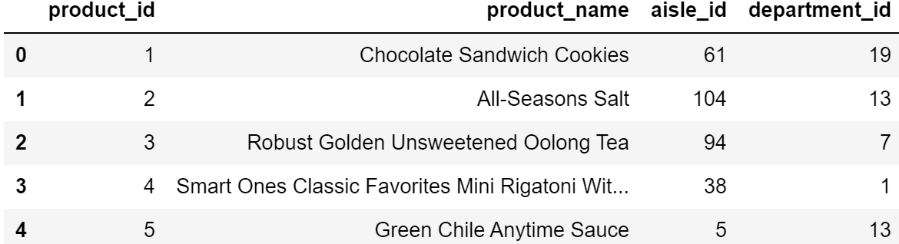
Departments.csv
21 departments
Aisles.csv
134 aisles
Products.csv
49k+ products

Slide 6
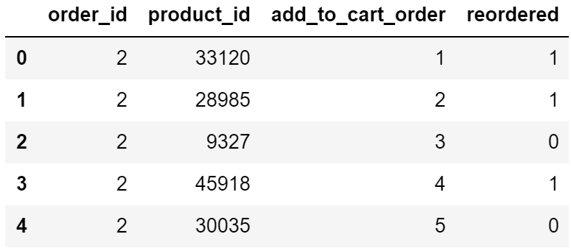
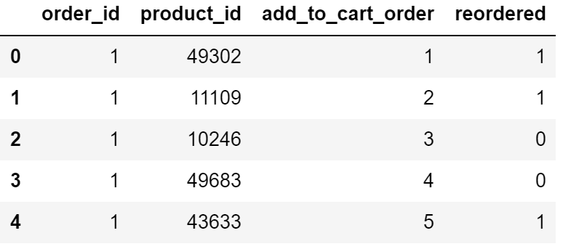
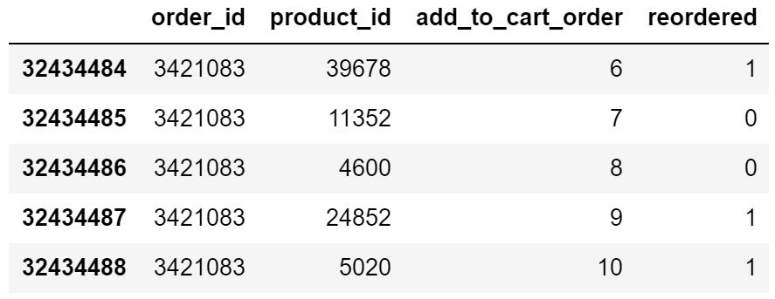
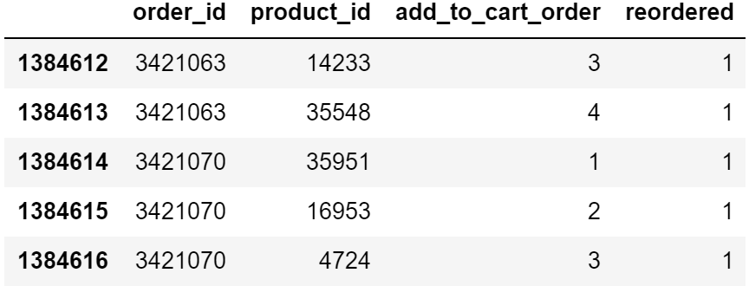
Order_products__prior.csv
32M+ rows
order_products__train.csv
1.4M rows
Prior/Train size split is 95.9%/4.1%

Slide 7
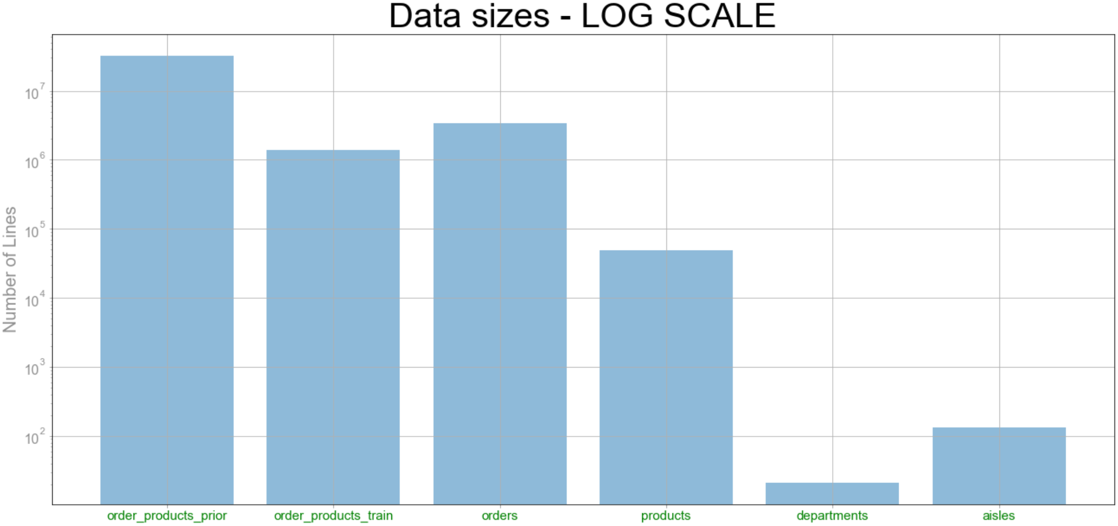
6 datasets - some substantial sizes up to 32M rows
Need for performance optimization
Some algorithms may be too computationally expensive

Slide 8
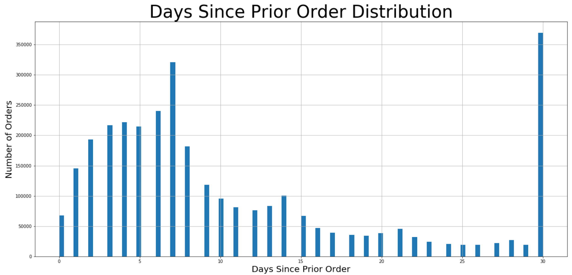
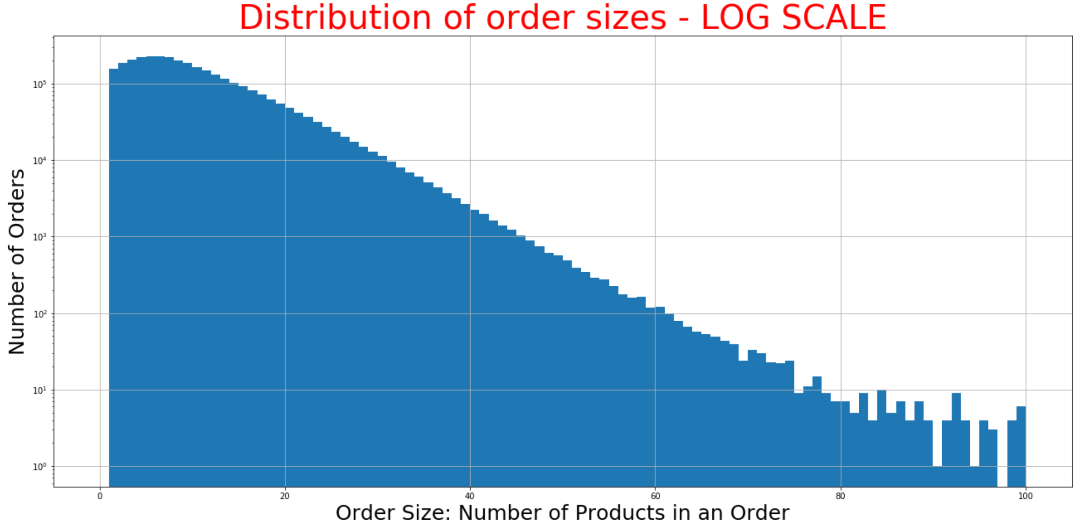
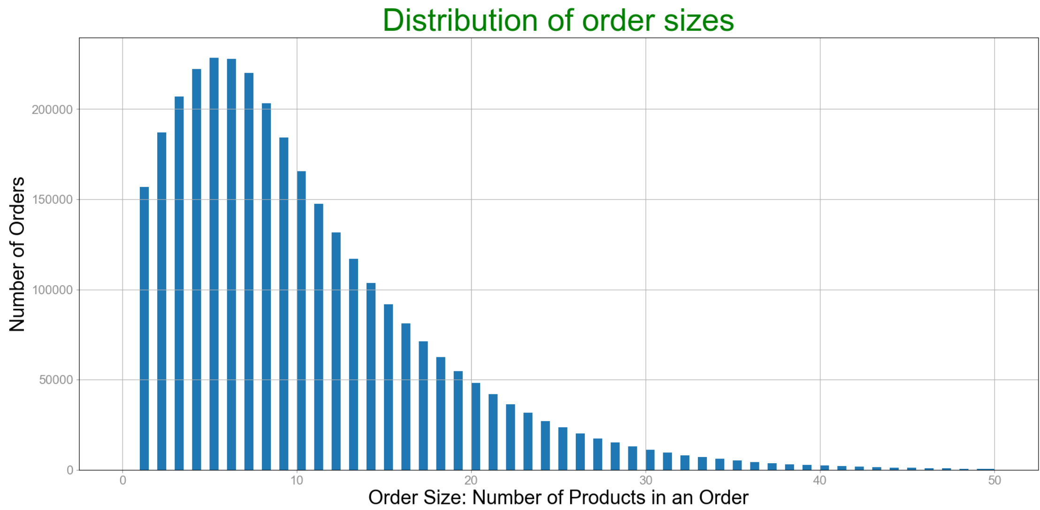
Reorders Peak at 7 & 30 days
30 days appears to be a cutoff
Smaller Weekly peaks
At 14, 21, 28 days
Order size ranges from 1 to 145
Order size stats:
Mean 10.08
Median 8
Mode 5

Slide 9
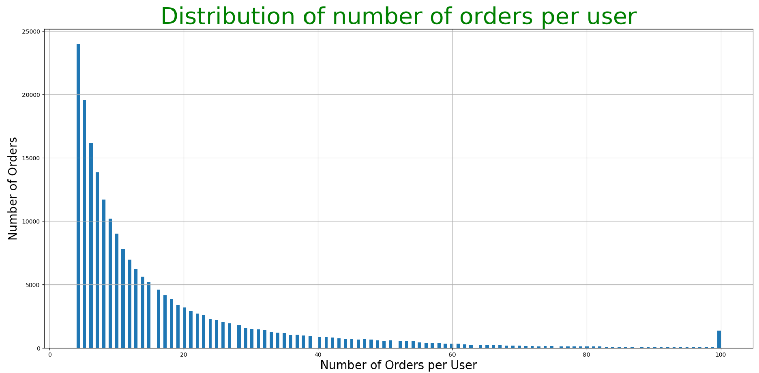
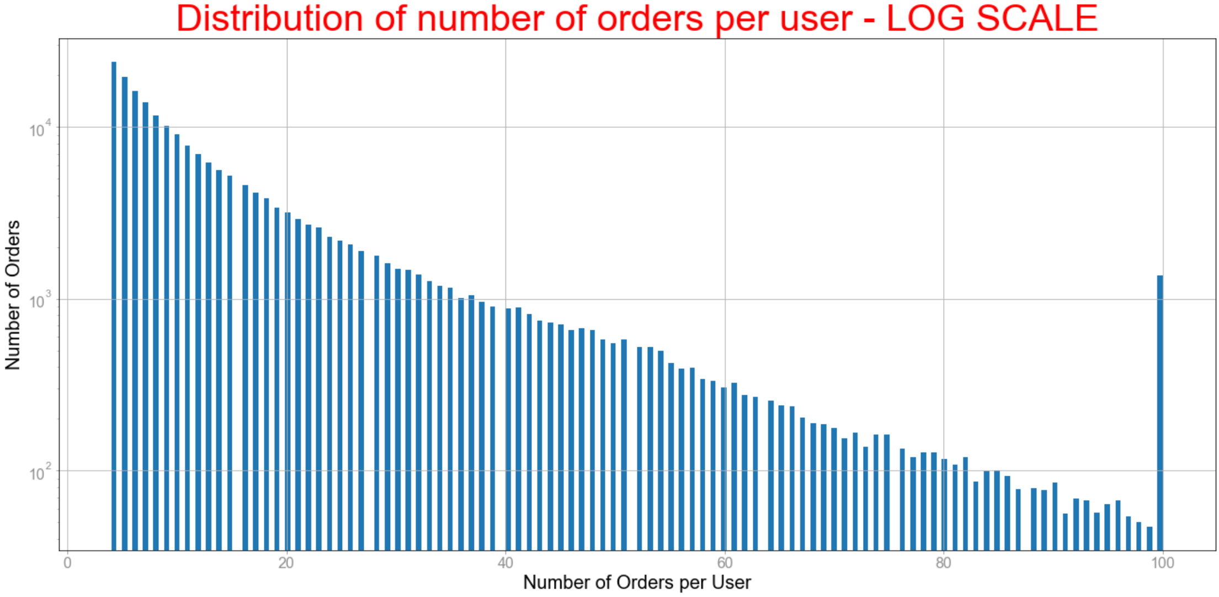
Peak at 100 is due to a cutoff
Log Scale is nearly inverse linear
Orders per User Stats
Range 4 to 100
Mean 16.59
Median 10
Mode 4

Slide 10
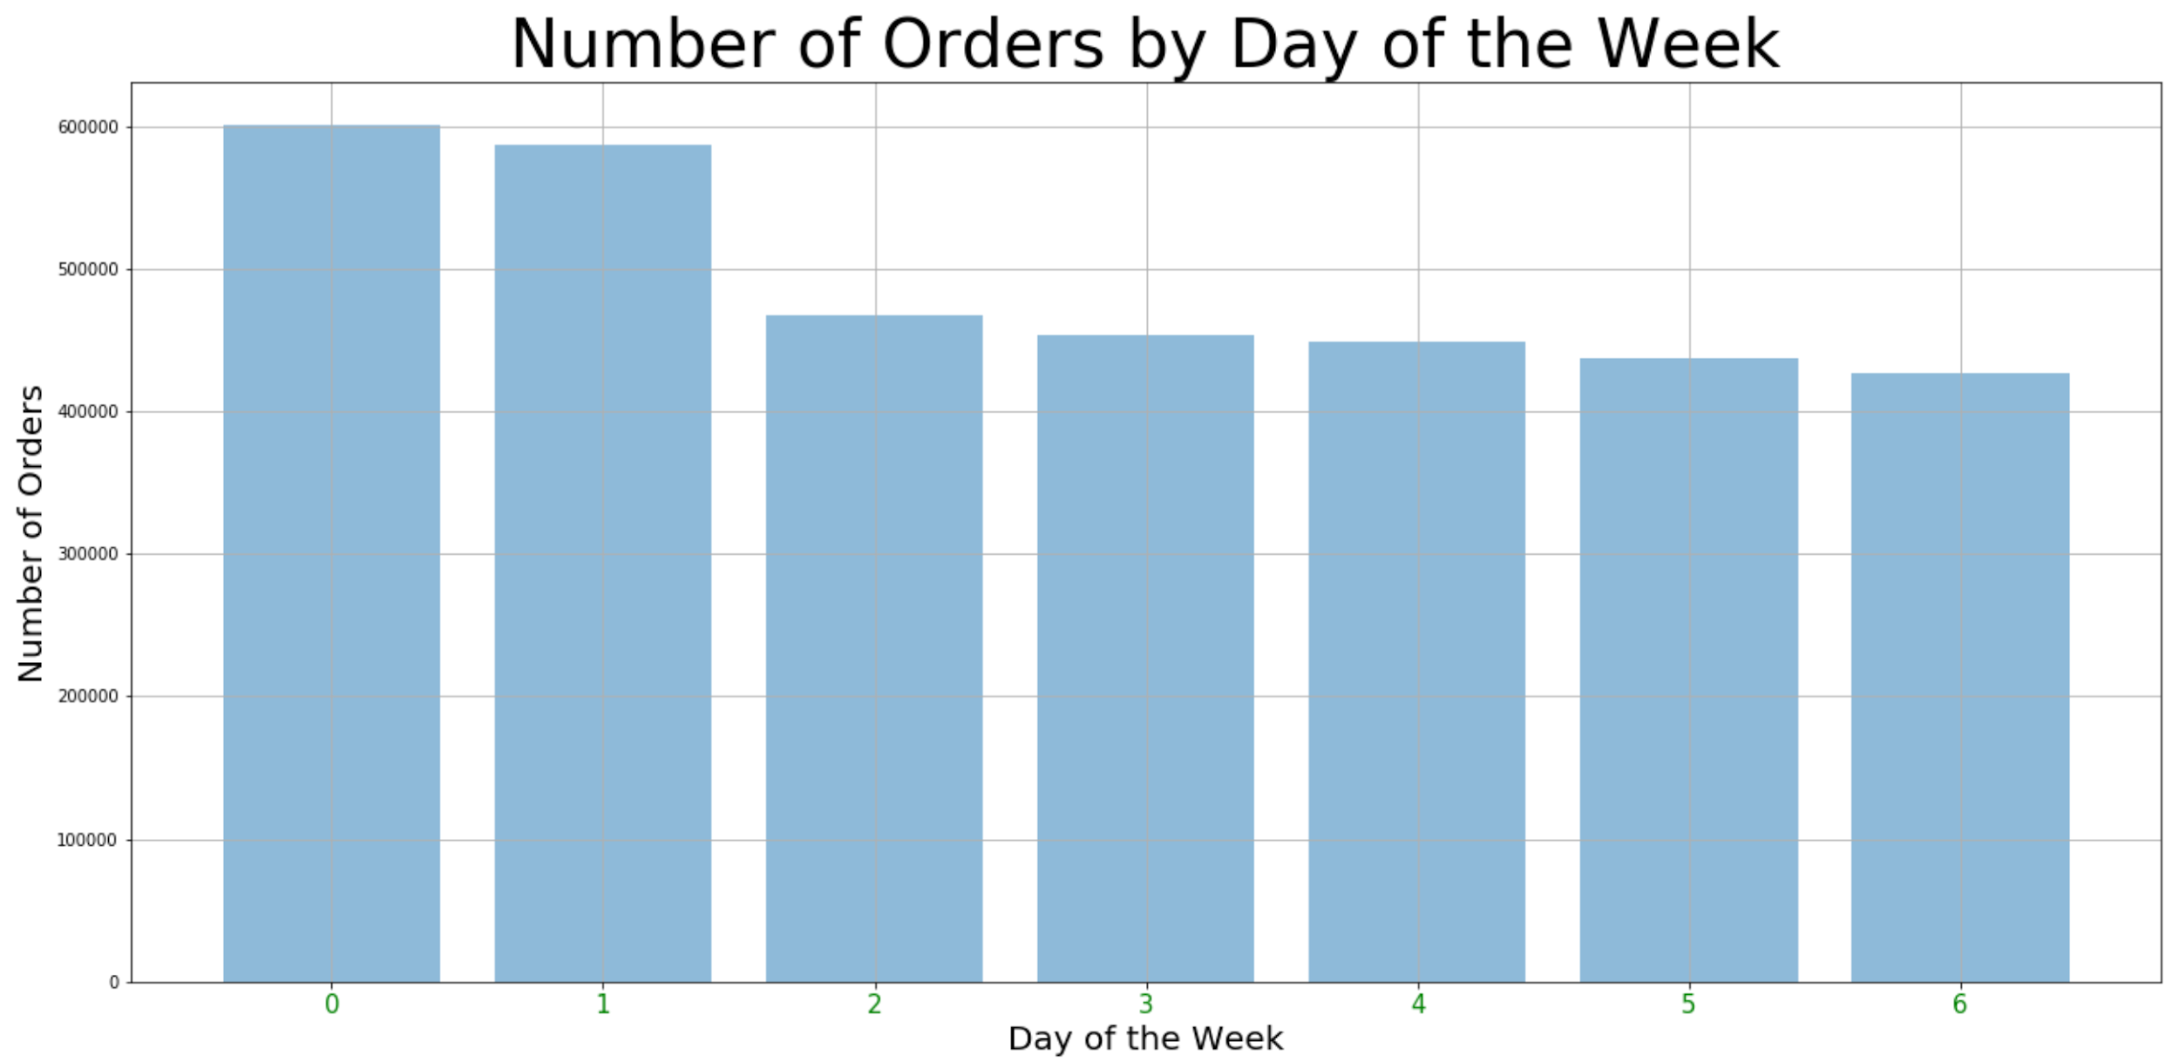
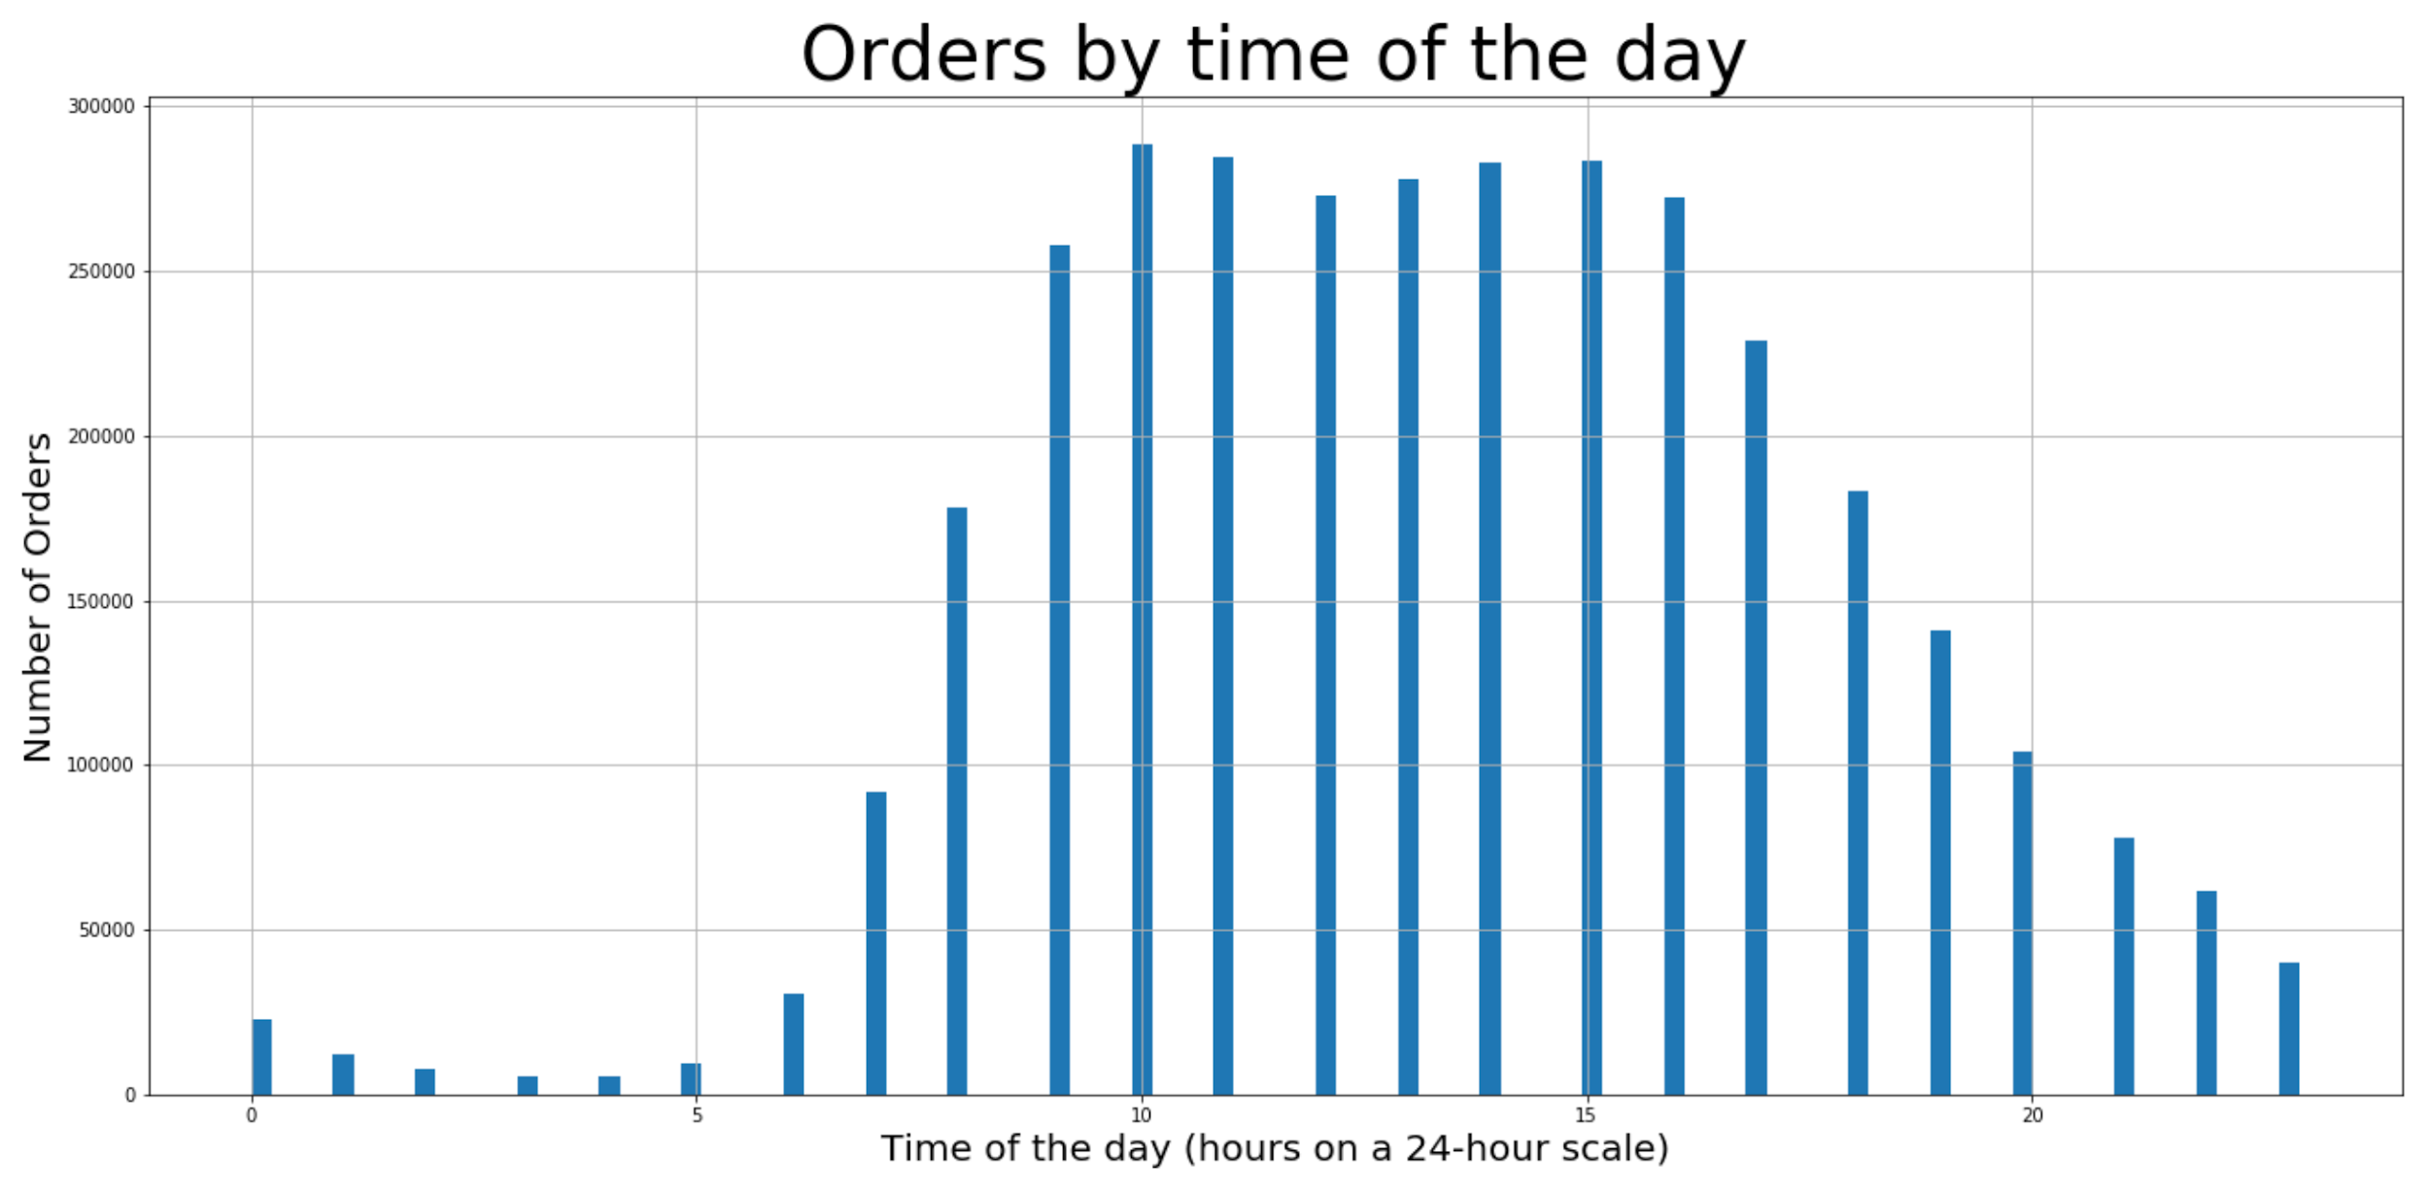
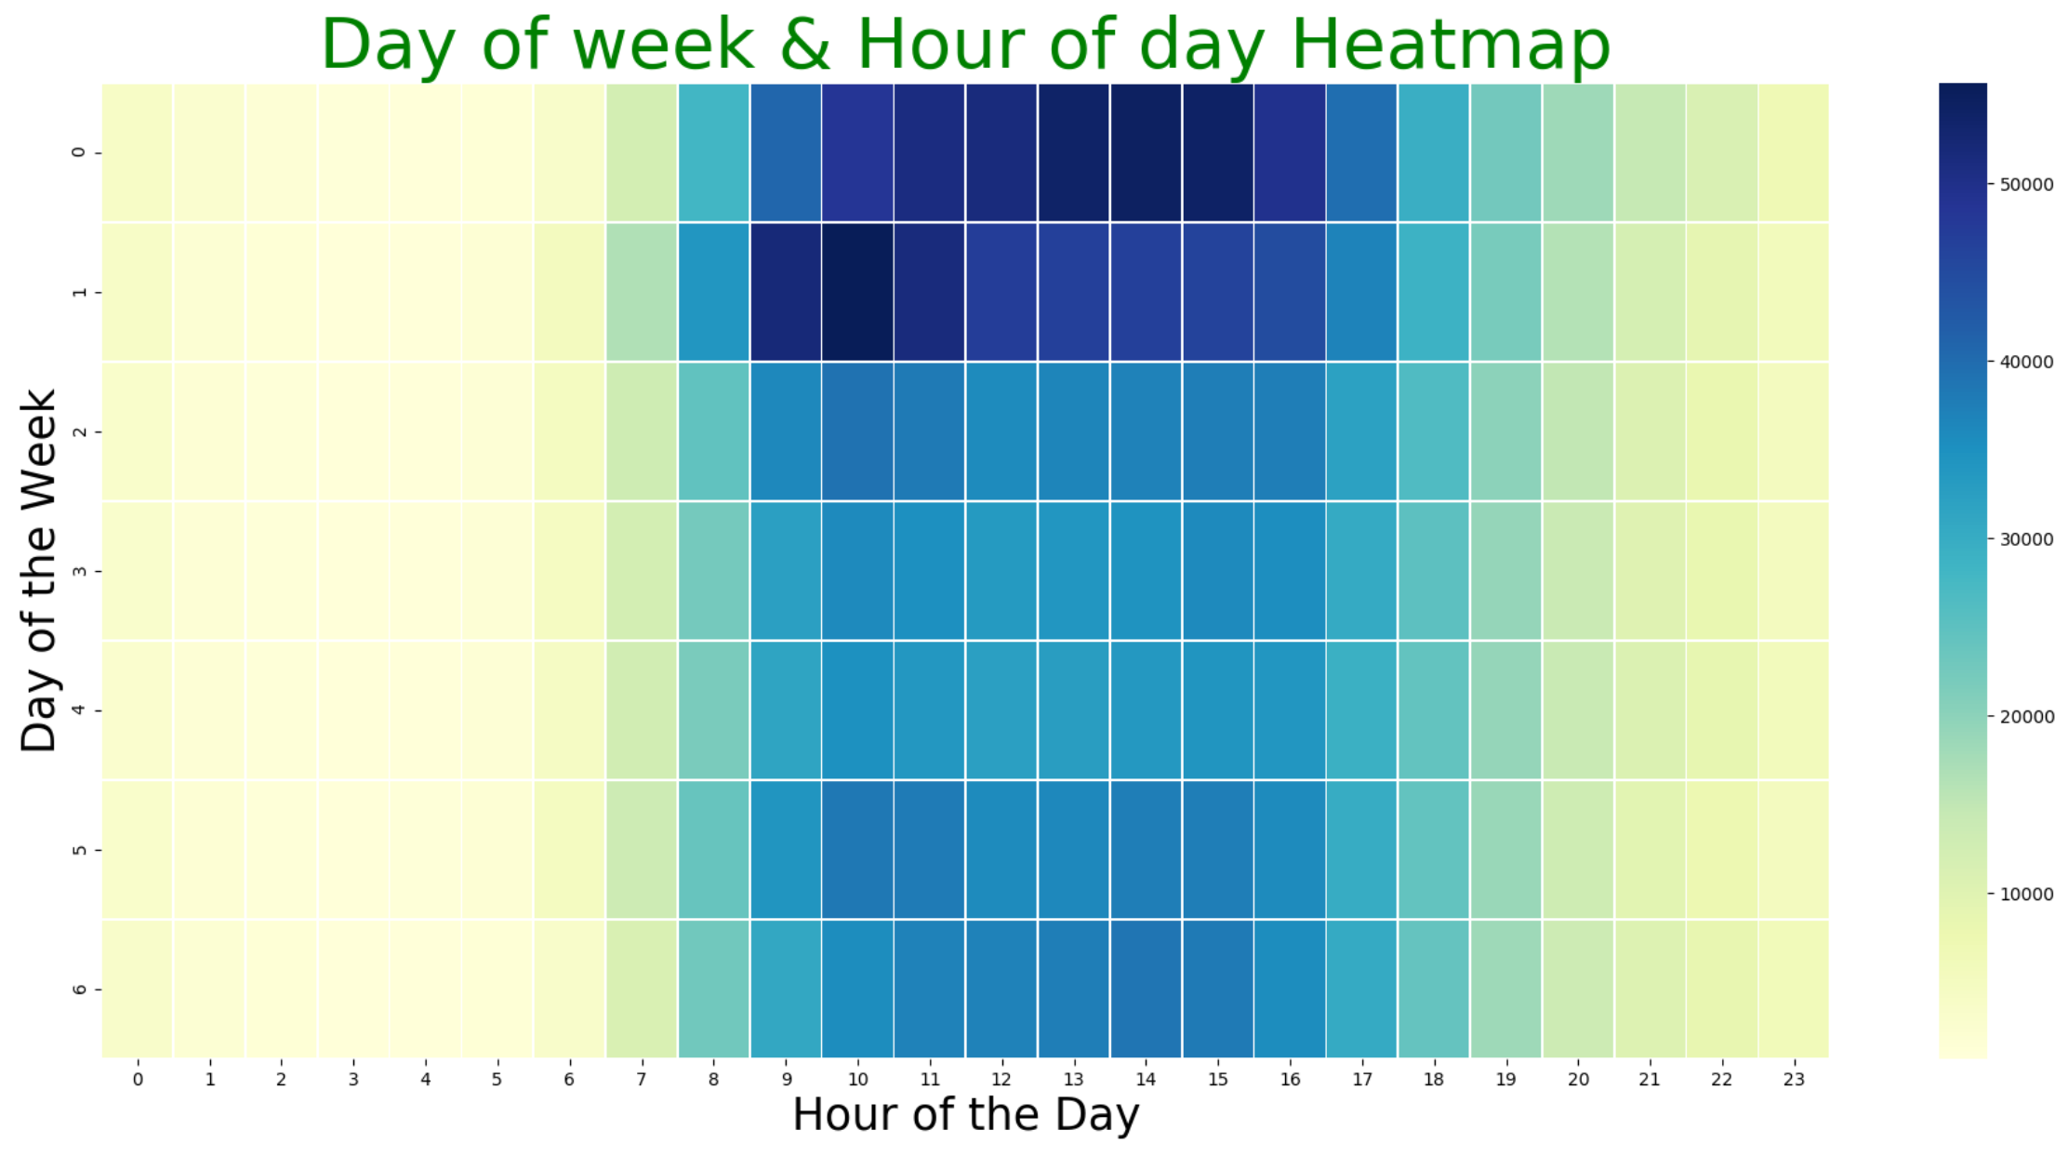
Peak orders on Saturday PM
and Sunday mornings

Slide 11
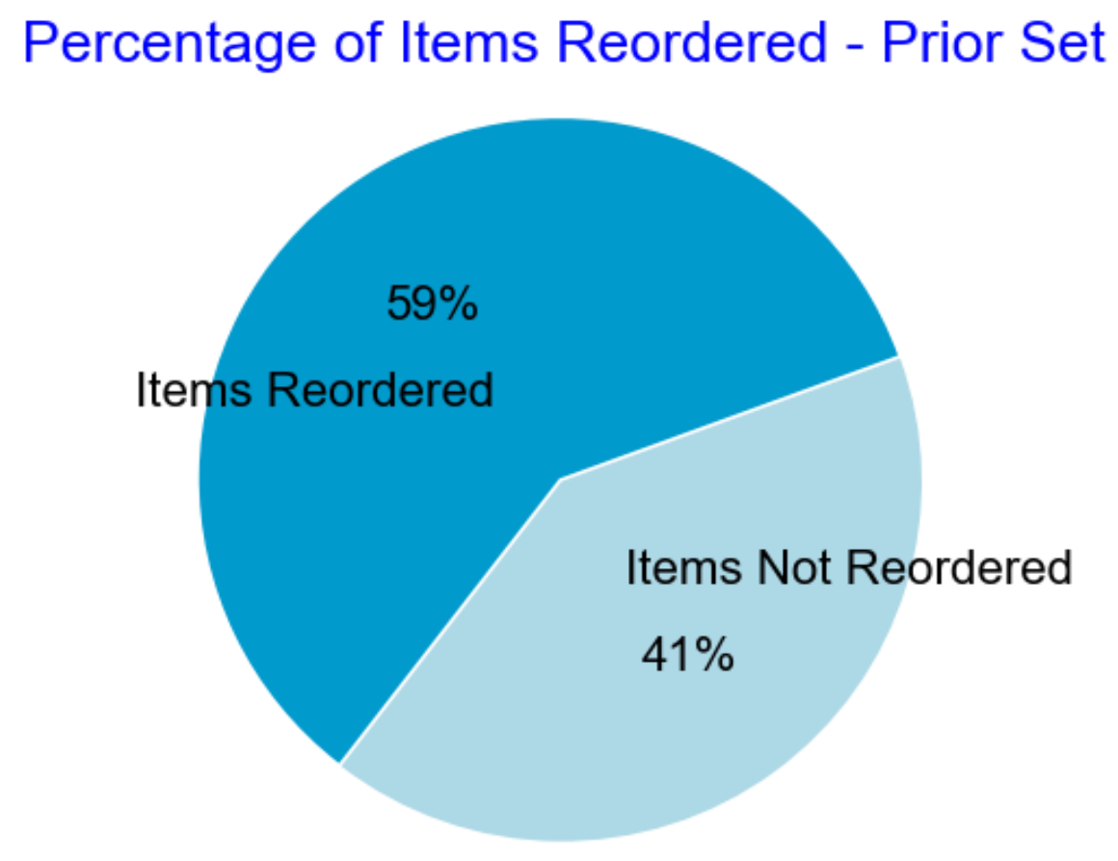
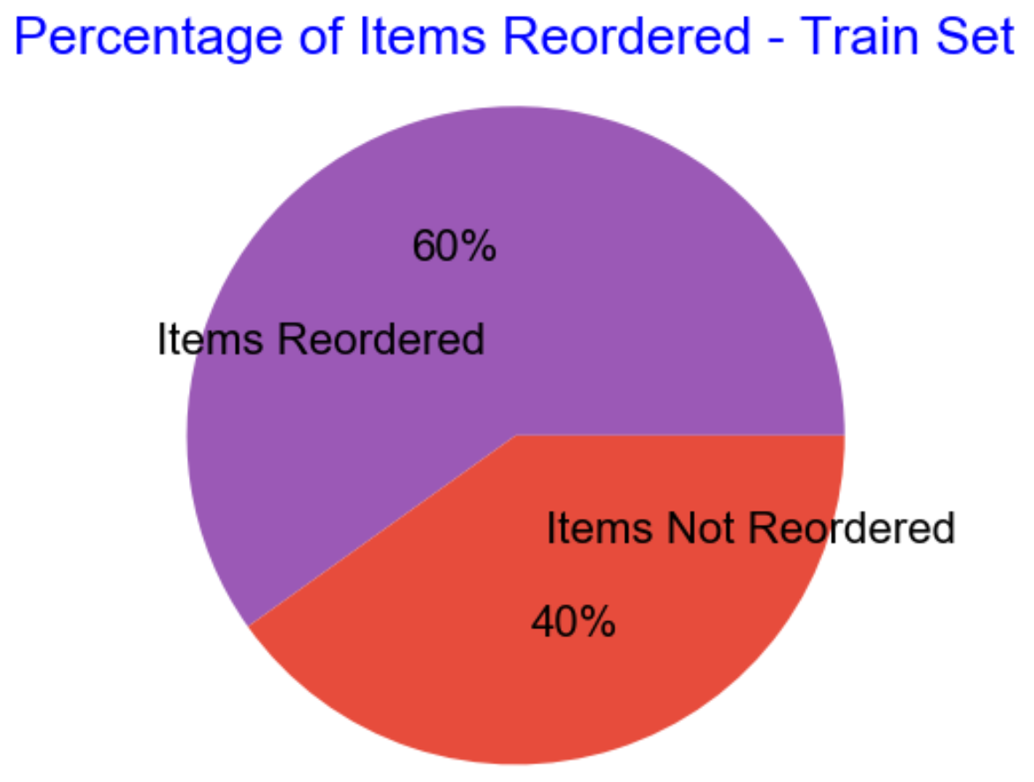
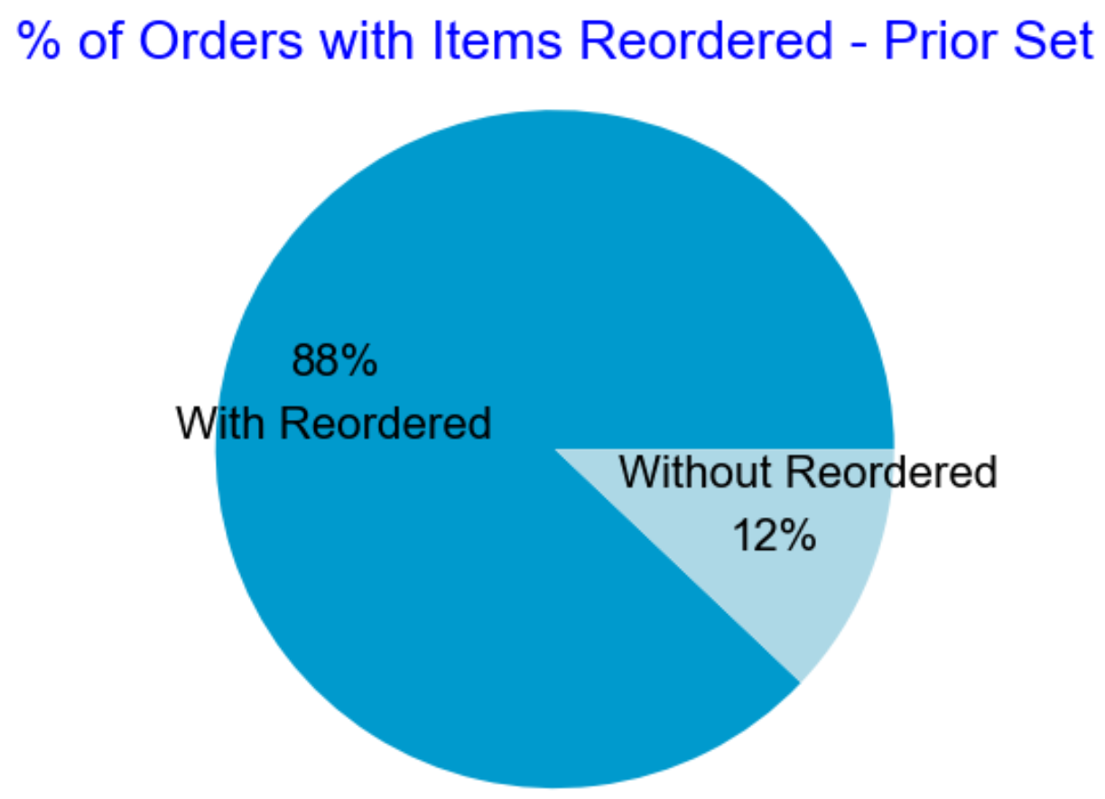
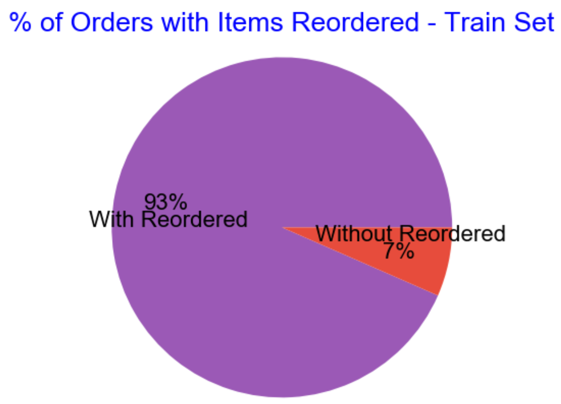
Top two charts - percentage of items that are reorders as opposed to first-time purchases.
Around 60% of items are reorders
Bottom two charts - percentage of orders with at least one item reordered.
Around 90% of orders have a reordered item

Slide 12
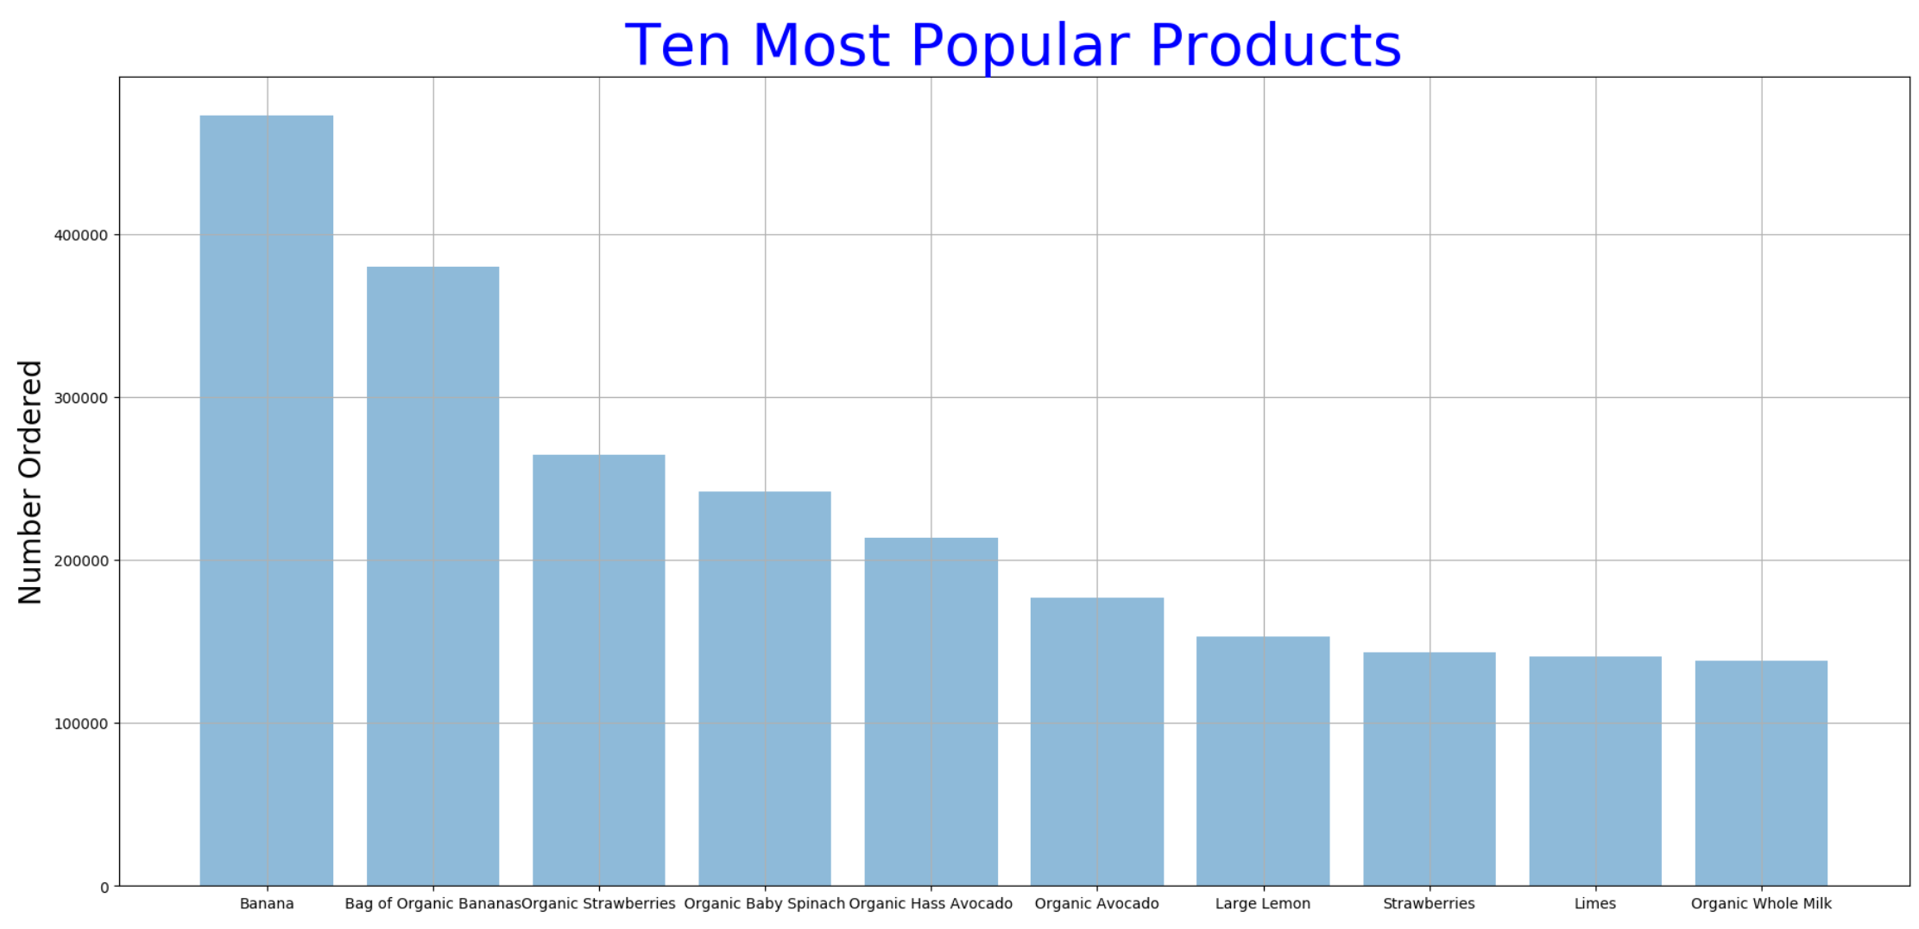
Top Ten Ordered Products are all Fruits, Vegetables, and Organics
The share of orders of top ten products among all orders is quite substantial at 7.16%, considering there are 49k+ products!

Slide 13
Customer Segmentation
Market and customer segmentation are some of the most important tasks in any company. The segmentation done will influence marketing, sales decisions, and potentially the company’s survival.

Slide 14
Initial Exploration
49677
200k+
134
Products
Users
Aisles

Slide 15
Dimension Reduction
Scale Data
PCA
Raw Data
Fit Data
Rotates data samples to be aligned with axes
Transform
Shifts data samples so they have mean 0
No information is lost
Plot

Slide 16
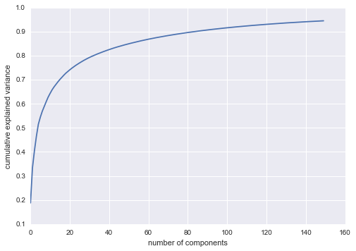
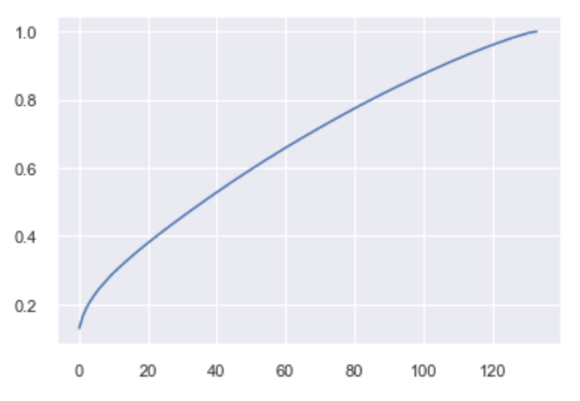
Explained Variance Plot

Slide 17
K-means Clustering
01
02
Find Best k
03
Fit & Predict
Plot & Pray

Slide 18
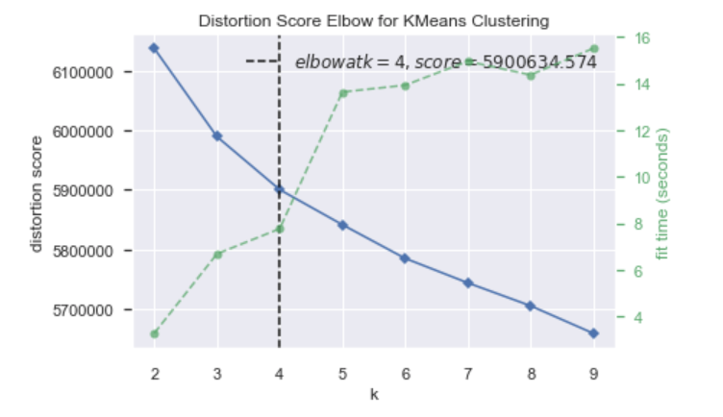
Best K

Slide 19
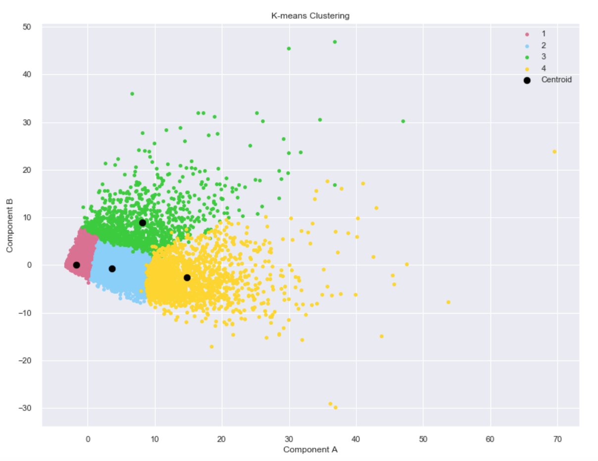
Plot

Slide 20
Other Clustering
DBSCAN
t-SNE
Does not require the number of clusters as a parameter
Technique for dimensionality reduction
Infers the number of clusters based on the data
Well suited for visualization of high-dimensional datasets

Slide 21
Cluster Characteristics
1
2
3
4
Aisle
Mean
Aisle
Mean
Aisle
Mean
Aisle
Mean
Fresh Fruits
8.313
Fresh Fruits
39.824
Fresh Fruits
24.904
Fresh Fruits
106.501
Fresh Veg
7.595
Fresh Veg
39.130
Fresh Veg
18.820
Fresh Veg
96.122
Packaged Veg
3.982
Packaged Veg
19.382
Yogurt
14.650
Packaged Veg
49.863
Yogurt
3.071
Yogurt
15.410
Seltzer
14.308
Yogurt
44.727
Seltzer
2.243
Cheese
10.565
Packaged Veg
13.635
Cheese
31.537
Cheese
2.064
Milk
9.450
Paper Goods
12.628
Milk
25.959
Milk
1.917
Seltzer
7.982
Cheese
12.084
Pretzels
19.852
Pretzels
1.620
Pretzels
7.502
Pretzels
11.806
Baby Formula
18.123
Soy Milk
1.444
Soy Milk
7.362
Soft Drinks
11.619
Soy Milk
17.855
Refrigerated
1.309
Bread
6.24
Milk
10.699
Bread
17.661

Slide 22
Summary
Business Uses
Future Scope
Determine appropriate pricing
Develop marketing campaigns
Design optimal distribution strategy
Offer promotion to loyal customers
Incentives for new shoppers
RFM (recency, frequency, monetary) analysis
Product2Vec
Hierarchical clustering
Add demographics
Customer segments as labels for predictive classification algorithm

Slide 23
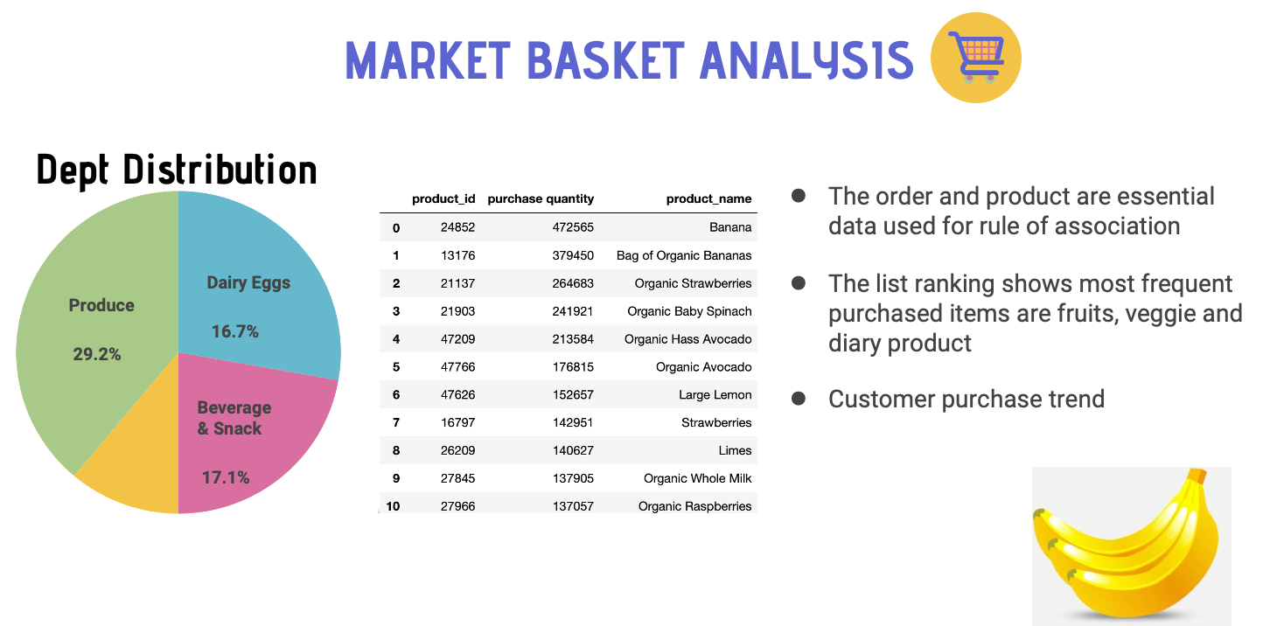
Notes:
●Primary data used for this analysis consist of Order and products
●Most frequent item – ranking showing fruits, veggie and diary products. We see there are similar product that could be grouped together
●The dept distribution – showing Product and Dairy eggs accounted for almost 50 % of the total purchase.

Slide 24
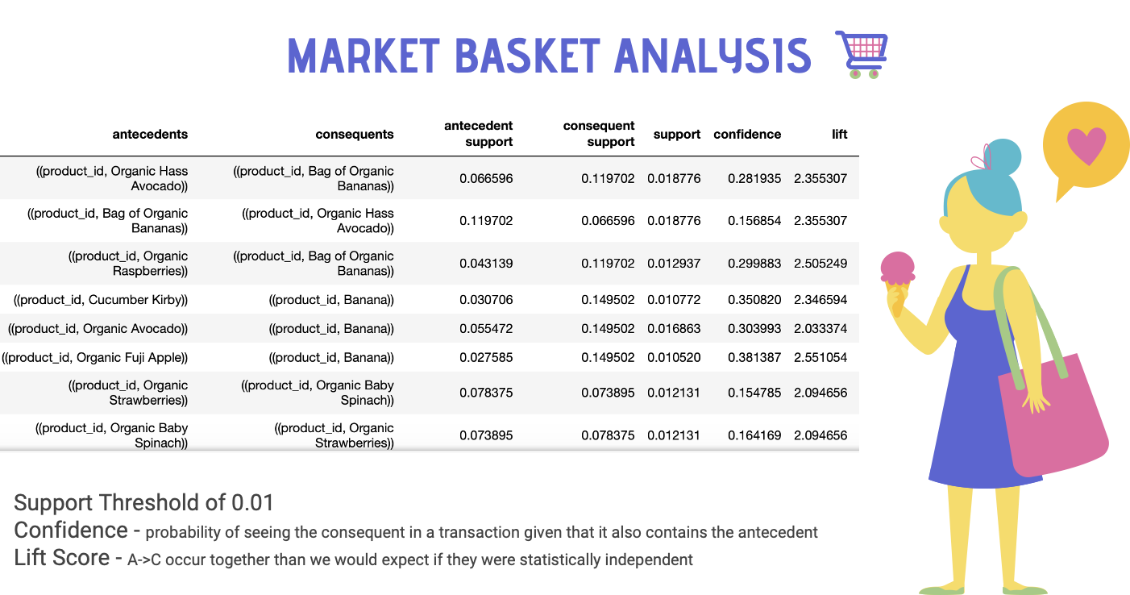

Slide 25
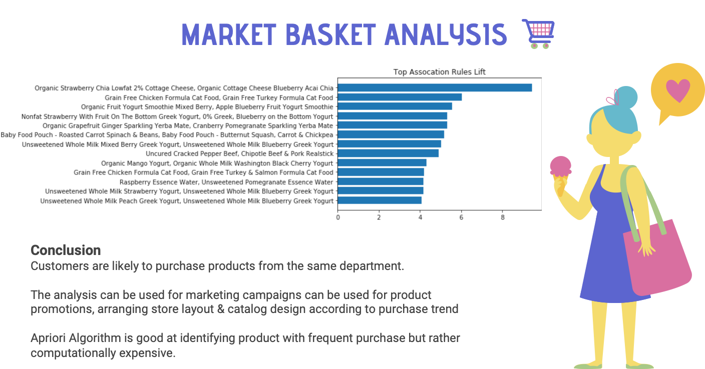

Slide 26
Recommendation System
Can we give people what they want, before they know they want it?

Slide 27
Recommendation System
Can we give people what they want, before they know they want it?
…maybe

Slide 28
Recommendation System
Can we give people what they want, before they know they want it?
Product2vec
Collaborative filtering
Turning all products into a big matrix
Find what other people also bought

Slide 29
Word2Vec Overview
M
Model
M
Methodology
V
Validation
Skip-gram, to fit our objective of providing recommendations based on products
Model trained based on product_id, where sentences were all the IDs per order
Use an average vector of all products in the order to make recommendations
Assumed each item was of equal importance (no weighting for items added first)
Compared our recommended items to the rest of the order
Notes:
MODEL: Word2vec processes text by vectorizing words. It takes in text and outputs vectors and is a two layer neural network. We chose the skip-gram model over the continuous bag of words (CBOW), because we are not trying to predict a current word. The model builds a vocabulary based on the training set and outputs a K-dimension vector for each word in the dictionary. The output vector is a feature vector that represents the word.
“In pattern recognition and machine learning, a feature vector is an n-dimensional vector of numerical features that represent some object. “ -wikipedia
VALIDATION: There is no generally accepted way to measure a word2vec model’s accuracy. As mentioned earlier, we are not trying to predict a current word, which is why we did not opt to use CBOW. However, we do check how our recommendations line up with the rest of the order (for instance, if an order with many organic items would have recommendations of other organic items.) If our recommendations are similar to the items that exist in the order, we consider it to be a relatively successful prediction
METHODOLOGY: Due to the size of the dataset, we opted to use product_id instead of product_names. Because we are only able to pass one vector into the recommendation model, we took the average of the vectors of items. We obtained vectors of the product_ids by passing them through the trained model, and recommendations are obtained by passing the vector through model.similar_by_vector().

Slide 30
Similar Products?
What is apple juice similar to?

Slide 31
Similar Products?
What is apple juice similar to?
Item
Similarity
Score
Mean of difference of vectors
Cranberry Juice Cocktail, .809 n/a
Original Orange Juice, .776 .141
Lemonade, .772 .156
Pulp Free Orange Juice, .727 ,155
Raspberry Lemonade, .712 .173
Notes:
https://github.com/RaRe-Technologies/gensim/blob/develop/gensim/models/keyedvectors.py#L485
Similarity score = cosine similarity (cosine between two vectors); positive words contribute positively, negative negatively

Slide 32
Recommendations
Results
Let’s look at order_id 232454. There are originally 17 items in the order
All Natural Marinara Sauce
European Cucumber
Vine Ripe Tomatoes
Red Onion
Honeycrisp Apple
Coconut Flavored Sparkling Water
Fresh Ginger Root
Low Fat Split Pea Soup
Select-A-Size White Paper Towels
Heavy Duty Scrub Sponges
Tall Kitchen Bags, Drawstring, Lavender, 13 Gal, Mega Pack
Yellow Onions
100% Natural Beef Broth
Super Spinach! Baby Spinach, Baby Bok Choy, Sweet Baby Kale
Coffee, Coffee BuzzBuzzBuzz! Ice Cream
Traditional Rope Hung Smoked Scottish Salmon
Green Tea with Ginseng and Honey
The ten predicted items are:
Ice Cream Cake Celebration
Cookies
Unsweetened Lemon Flavor Real Brewed Tea
Variety Pack Grab & Snack
Organic Fruit Snacks Bunch O’ Berries
Natural Premium Coconut Water & Pineapple Juice from Concentrate
Strawberry Banana on the Bottom Greek Yogurt
Chips Deluxe Mini Rainbow Cookies
Clear Strips
Frosted St. Patrick’s Day Cookies

Slide 33
Business Uses and Considerations
Is average vector the way to go?
Missing data?

Slide 34
Modeling: why we chose LightFM
01
02
03
What is it
What does it do
How does it work
A hybrid latent representation recommender model that’s suitable for high-dimension.
LightFM produces scores for every item for a given user, high score indicating higher likelihood of purchase
Maximises the rank of positive examples with WARP loss function.

Slide 35
Data Processing
Original dataset
Sparse.coo.matrix
20%
User
Order
…
Product
…
ID
ID
…
User
Quantity
…
…
…
…
80%
Test
Train

Slide 36
Model output
Customer already have:
Cinnamon Swirl French Toast
Rose Hips Tangerine Slippery Elm Lozenges
Fresh Organic Carrots
Lifewater 0 Cal Blood Orange Mango Vitamin Enriched Water
Sweet Orange Marmalade
Simply Clean & Fresh HE Liquid Laundry Detergent, Daybreak Fresh Scent, 89 Loads
Steel Cut Oats
Sourdough Hearty Sliced Bread
Top Recommendations:
Garbanzos Classic Chickpeas
Pure Demerara Cane Sugar
Peppermint Patties
Throat Shield Rapid Relief Herbal Tea
Original Cheese
Acti-Fresh Body Shape Regular To Go Pantiliners
Snack Bites
BelVita Golden Oat Breakfast Biscuit Packets
White Whole Mushrooms
Sweet Orange Marmalade

Slide 37
Modeling Evaluation - Collaborative Filtering
AUC
Precision at k
Likelihood of a random positive item recommended over a negative one
Percentage of total actually purchased items that were on the top k list
90%
5%
Notes:
https://medium.com/@m_n_malaeb/recall-and-precision-at-k-for-recommender-systems-618483226c54

Slide 38
Potential Improvements
C
Challenges
O
Opportunity
Our system is able to rate relevant items higher, when it comes to putting these items up front, it does a terrible job.
We don’t have information readily available on a use level.
Can we incorporate user and product information to make our recommendation system smarter?

Slide 39
Inferring customer gender
We think that by utilizing the data we have, it is possible to infer a users’ gender based on their purchase history. In fact, we have a specific item feature that indicates whether or not a product belongs to the feminine care aisle.
While we fully acknowledge that this assumption is by no means perfect for many reasons… here, we implemented this user feature out of pure academic curiosity.

Slide 40
Modeling Evaluation - Hybrid Model
AUC
Precision at k for all three models
Model with user/item or with only user features: 92%
Model with only item feature: 93%
Percentage of total actually purchased items that were on the top k list
93%
5%

Slide 41
Comparing our results
Toilet Paper is most similar to...
Similar products based on collaborative filtering
Similar products based on hybrid method with user/item features
Similar products based on Word2Vec model
'Organic Cream Cheese Bar',
'Baby Food Blueberry, Parsnip & Buckwheat Stage 2',
'Women Over 55 Multivitamin',
'Quinoa Cereal Honey Almond',
'Balsamic Soy Ginger Sauce',
‘12 G. Protein Bar Coffee Chocolate',
'Eye Makeup Remover Pads With Kiwi Extract No Fragrance Added',
'PM Sleep Aid Plus Pain Relief',
'Soft White Halogen 72 Watt Double Life Light Bulb',
'Exfoliating Hydro Gloves 1 pair'
Proactive Health Sensitive Stomach Cat Food
Whisk Broom with Dust Pan
Gold Temptation Refreshing Shower Gel
Himalayan Pink Salt Liquid Hand Soap

Slide 42
Conclusion
We’ve uncovered that there are definite patterns that emerge in the Instacart dataset, such as:
Orders peak on Saturday evenings and Sunday mornings- good time to restock or launch new products?
Marketing campaigns can be targeted to customers based on the cluster they are in to enhance success
Relationships found in market basket analysis can help to further refine recommendation systems
Some relationships have already been incorporated naturally, such as ‘Organic Fuji Apples’ being recommended as a similar product to ‘Bananas’ in the Word2Vec model

Slide 43
Thanks!
Please keep this slide for attribution.

